Slide 1
Prototype on 3D News App
Submitted By: prudhvi (150101055)
Ankit vyas (150101008)

Slide 2
Table of contents
Introduction……………………………………………………………………………….....slide 3
Login page………………………………………………………………………………..….slide 4
Forgot password…………………………………………………………………………......slide 5
Sign up page……………………………………………………………………………..…..slide 6
Profile management homepage……………………………………………………..….slide 7
Profile management dropdown menu 1……………………………………………..…slide 8
Profile management dropdown menu 2………………………………………….....….slide 9
E-wallet…………………………………………………………………………………….…..slide 10
Bookmarks………………………………………………………………………………….….slide 11
Trending news……………………………………………………………………………...…slide 12
Search……………………………………………………………………………………….….slide 13
Search results……………………………………………………………………………….....slide 14
Polyhedron initial position…………………………………………………………………..slide 15
Polyhedron after rotation…………………………………………………………………...slide 16
Selected news article from the polyhedron……………………………….……………slide 17
News article after scrolling, zooming……………………………………………..………slide 18
Page features………………………………………………………………………..………..slide 19

Slide 3
Introduction
This prototype shows critical functionalities of the app. Pictures are used which shows the UI and functions as well. Each feature/function has been explained along with the picture. This app helps in enhancing news reading experience. We have thought of the following features, which will help in giving a user great news reading experience:
Friends feature, which allows the user to befriend someone and see his/her news subscriptions, interests etc.
E-wallet, many news channels are paid, so an e-wallet will be present through which user can subscribe to paid news channels.
Narration of a text, if the user doesn’t want to read news on his/her own, then this option will come handy.

Slide 4
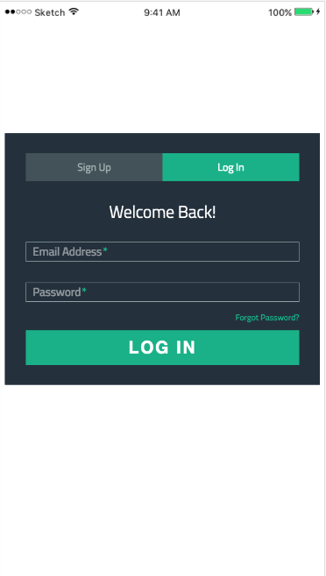
Login Page
This is the startup window. Users who are already a member can login with their email address and password. In case the user forgets the passwords, it can be reset using the “forgot password” option.

Slide 5
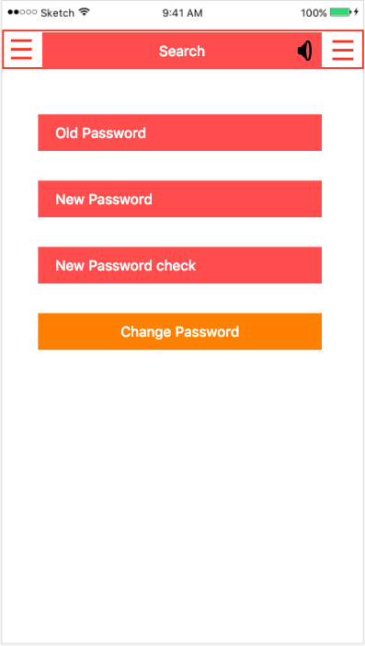
Forgot password?
This allows a user to reset his/her password.

Slide 6
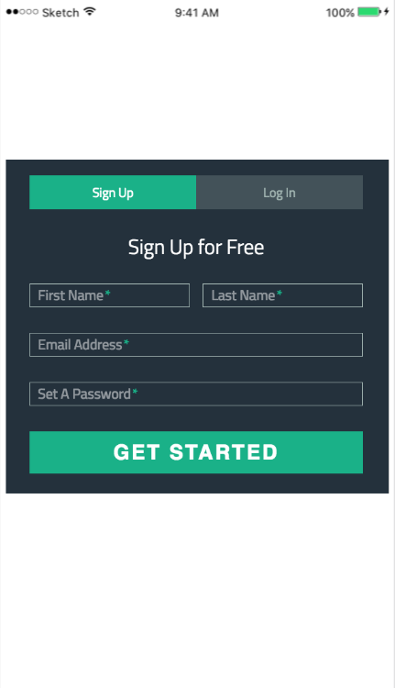
Sign Up Page
For new users, creating a new account for free is available. The user only needs to enter the his/her name, email address and set a password. An error message will be generated if:
Any field is left blank.
Password is less than 8 characters.

Slide 7
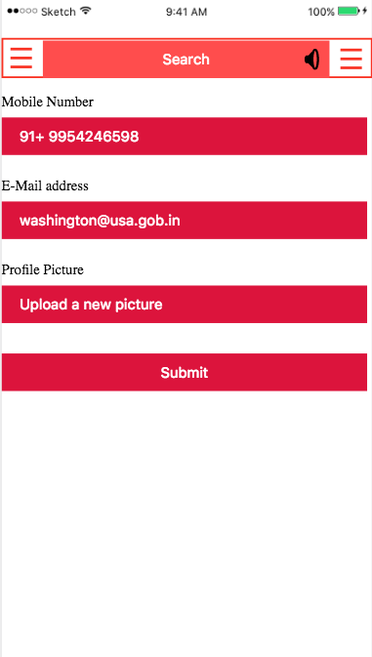
Profile Management homepage
After logging in the user will be directed to this page. On the left and right top corner of this page, there are two drop down menus which will allow the user to do various task.

Slide 8
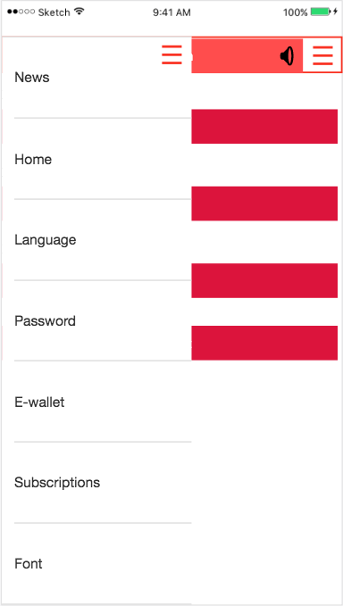
Profile Management dropdown menu 1
After clicking on the left dropdown menu, the user can do the following task:
Select language
Change password
Add/restore/check money in the e-wallet.
Check subscriptions to news channels.
Change font of the app.

Slide 9
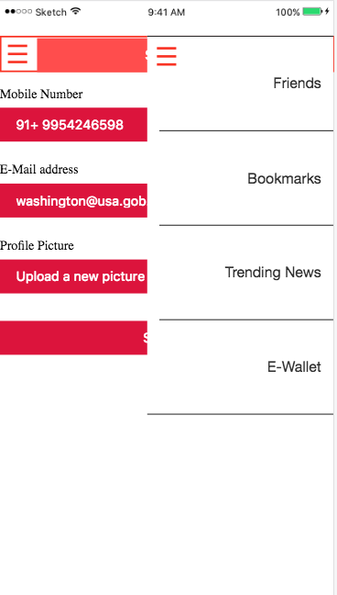
Profile management dropdown menu 2
In this menu, the user can accomplish the following tasks:
See the list of his/her friends.
See the bookmarked news articles.
See the trending news.
Manage e-wallet.

Slide 10
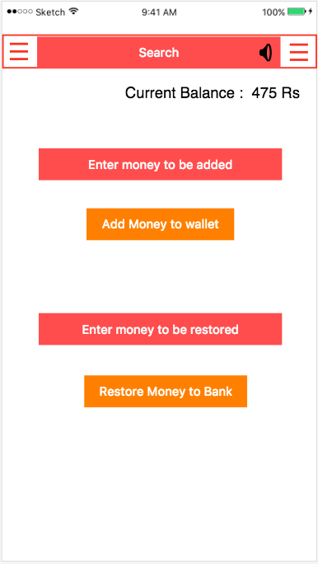
E-wallet
The money in the e-wallet will be used to subscribe to paid news channels.
In this page, the user can perform the following tasks:
Look the existing money in the e wallet.
Add money to the e-wallet.
Encash money to the bank.

Slide 11
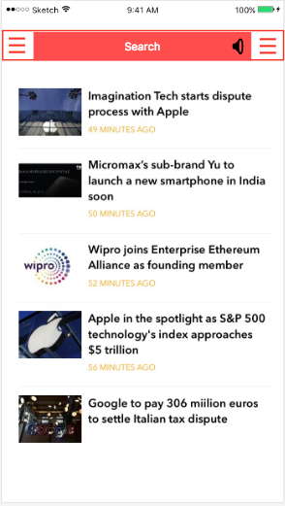
Bookmarks
This window shows the bookmarked news items. The user can un-bookmark any news article at any time.

Slide 12
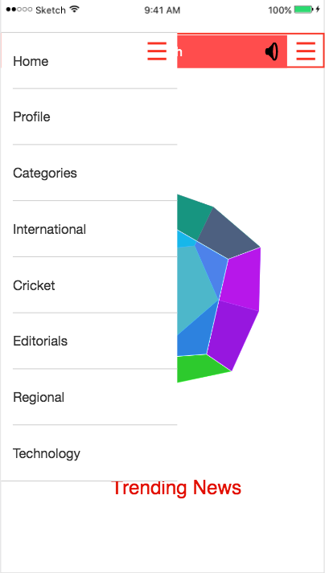
Trending news
This windows shows the trending news. This list is updated every hour. Also there is a drop down menu which allows the user to browse through different news categories.

Slide 13
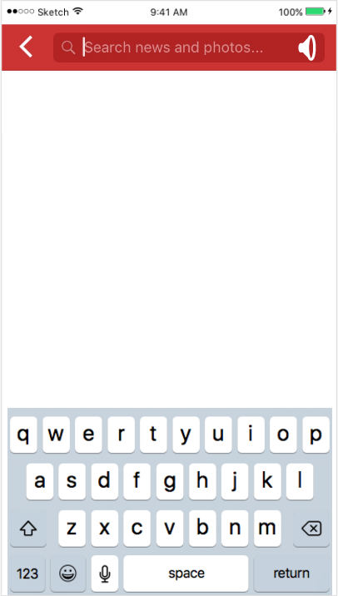
Search
This search utility allows the user to enter a keyword or search query. The app then looks into the database and show desired results. The search can be done via text or voice.

Slide 14
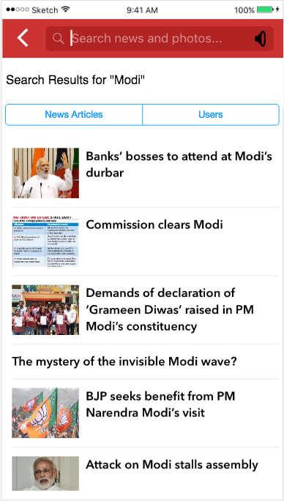
Search results
This window shows the search results for the keyword “modi”. User can select any of the article which he\she wants to read. If there is no search result found, a message will be displayed to the user stating, “no search results are found!”.

Slide 15
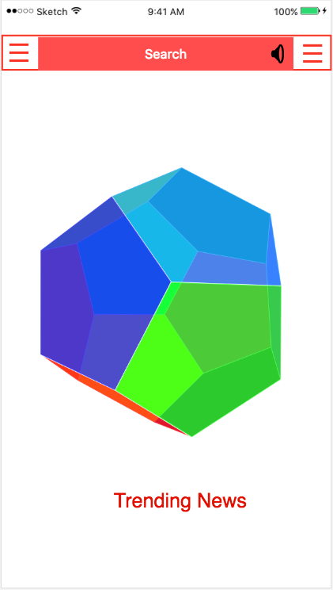
Polyhedron initial position
This is how the trending news page will look like. On each side of the polyhedron there will be a news article. User can rotate the polyhedron by mouse/hand gestures. And for selecting a particular new article user can click on it.

Slide 16
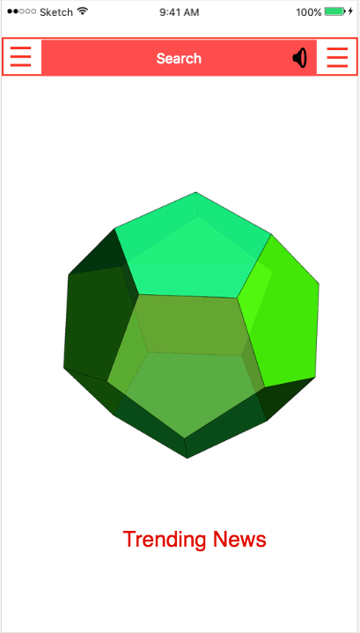
Polyhedron after rotating
By hand/mouse gestures user can rotate the polyhedron about any axis. This way user can explore all the sides of the polyhedron and hence all news articles.

Slide 17
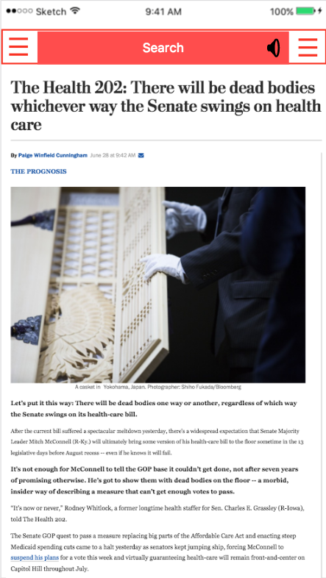
Selected news article from the polyhedron
After clicking on a particular news article on the polyhedron, the news article will open for reading. User can perform various tasks like zoom, scroll, highlight text, bookmark and many more.

Slide 18
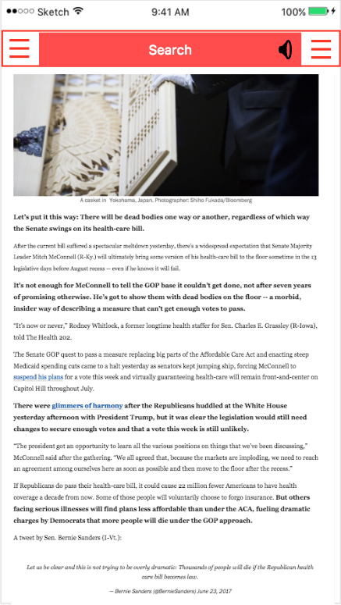
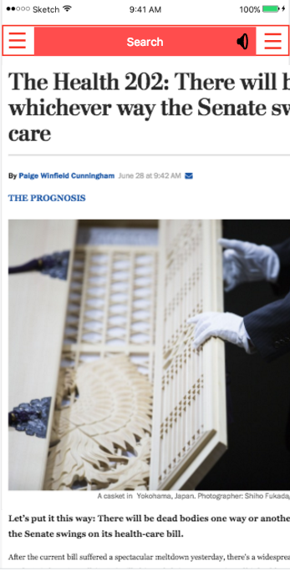
News article after scrolling, zooming
User can change the font size by pinching in and out using two fingers.
Down and up hand gestures scrolls the page up and down.

Slide 19
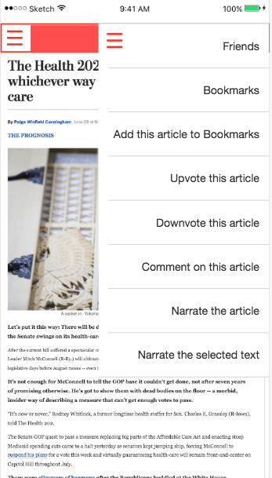
Page features
The following task can be accomplished in the drop menu:
Bookmark the news article.
Upvote or downvote the news article.
Comment on the news article.
Make the computer to narrate the whole article or some selected text.

Slide 20
Thank you!

